Slide 1
Group 6
The Library Management System
Team work 2
A10523006 Maggie
A10523049 Peggy
B10423003 Kurumi
B10423029 Bean
B10523020 Kendy
B10523030 Jerry
B10523053 Lynn
M10723001 Joe

Slide 2
Content :)
(1) Law of Demeter (LoD)
(2) Coupling
(3) Cohesion
(4) Connascence
(5) CRC card
(6) Contract, Method specification, Activity diagram
(7) Data coupling, Cohesion, Convention connascence
(8) Referential integrity
(9) Normalizationions
(10) Denormalize and New Class diagram
(11) Inter-file clustering and Index strategies

Slide 3
(1) Law of Demeter (LoD)

Slide 4
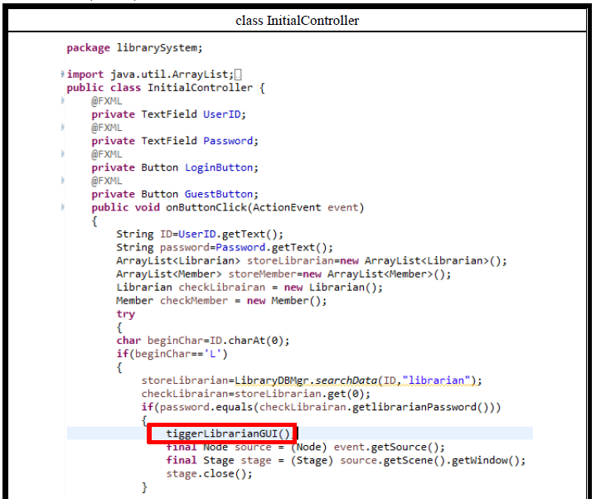
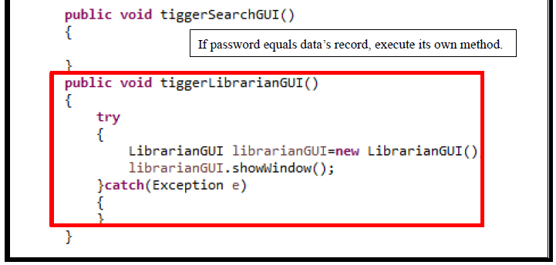
1-1. to itself (O itself)

Slide 5
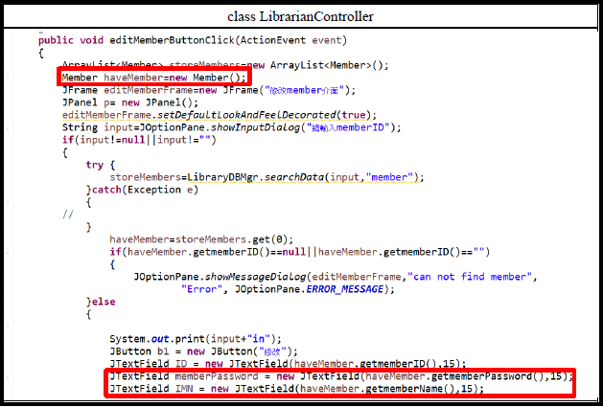
1-2. Any objects created/instantiated within M

Slide 6
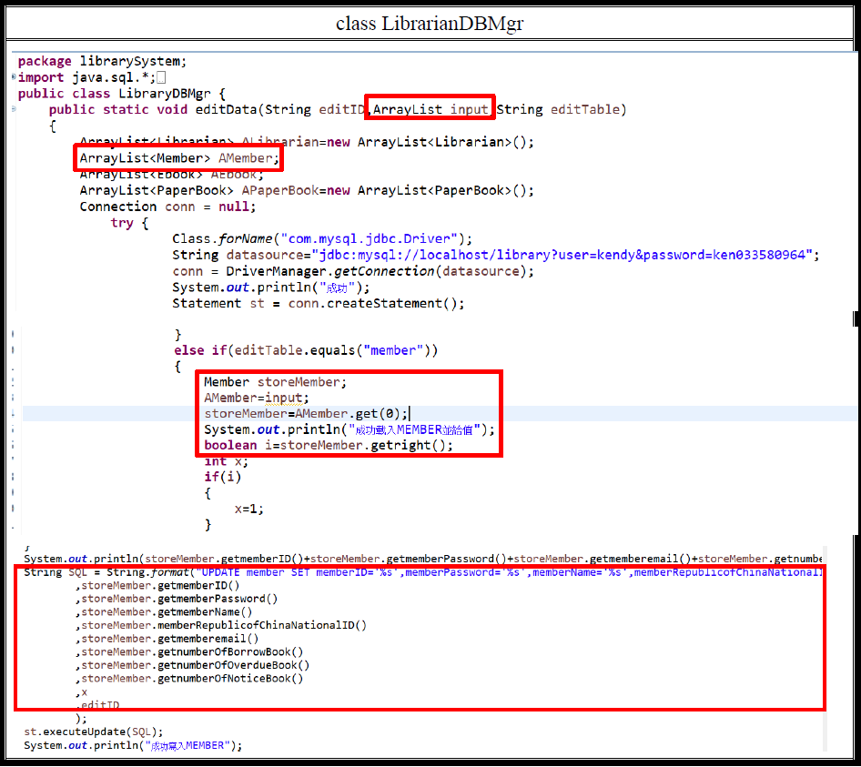
1-3. to an object that is passed as a parameter to the method (M’s parameters)

Slide 7
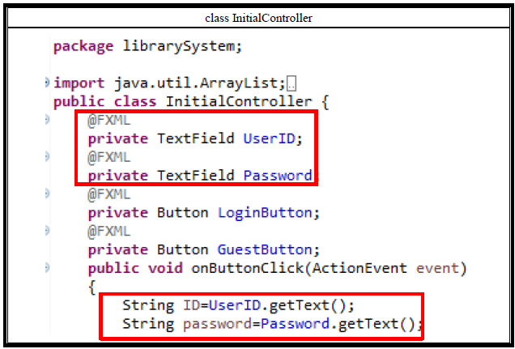
1-4. to an object that is created by the method (O’s direct component objects)

Slide 8
(2) Coupling

Slide 9
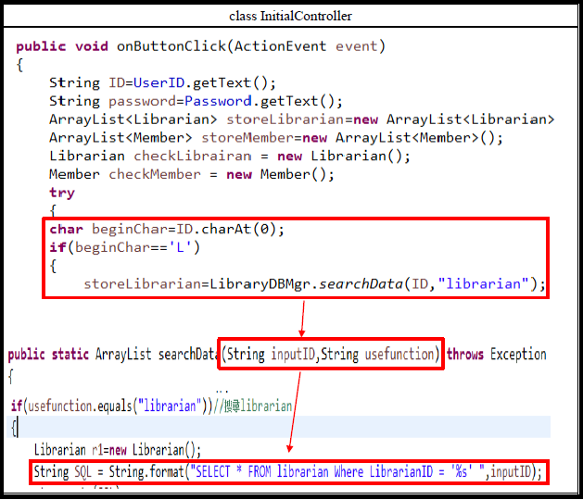
2-1. Control Coupling

Slide 10
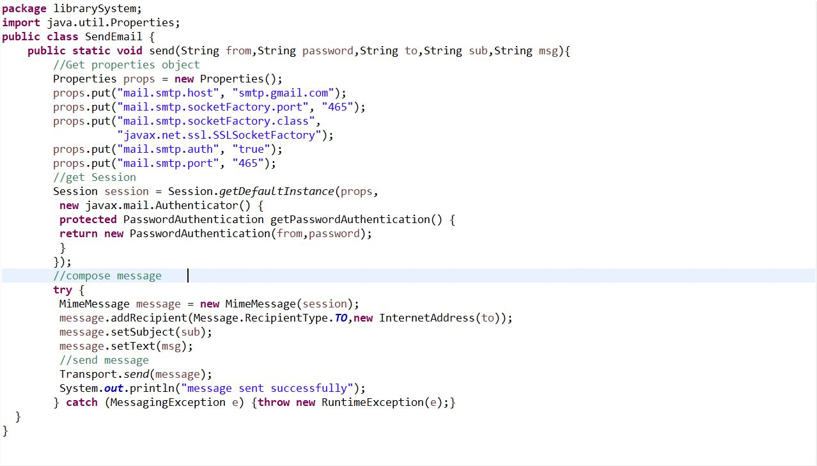
2-2. Interaction, Data Coupling

Slide 11
2-3. Stamp Coupling

Slide 12
(3) Connascence

Slide 13
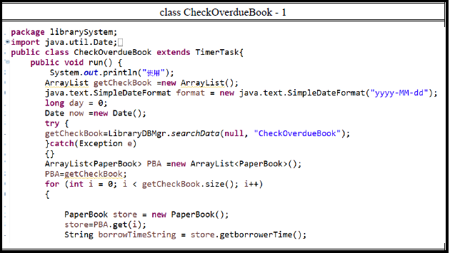
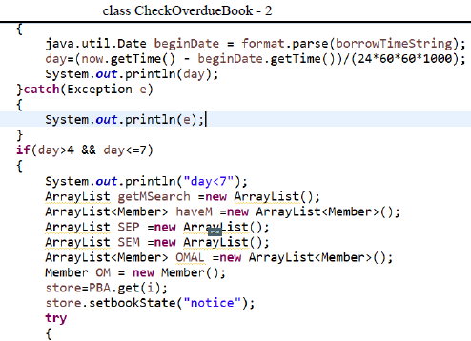
3-1. Function Cohesion

Slide 14
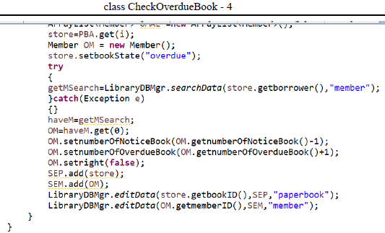
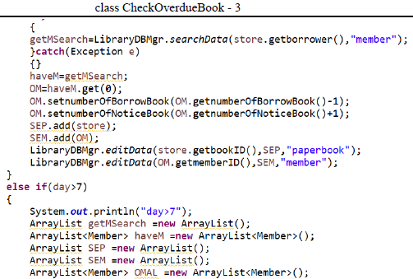
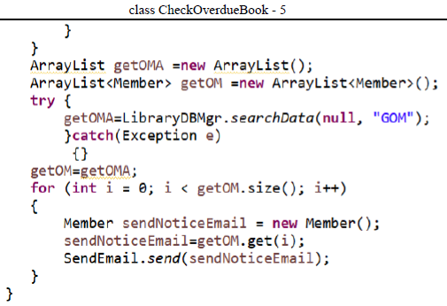
3-1. Function Cohesion

Slide 15
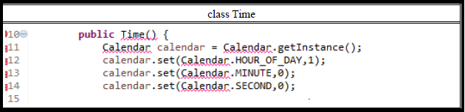
3-2. Temporal Cohesion

Slide 16
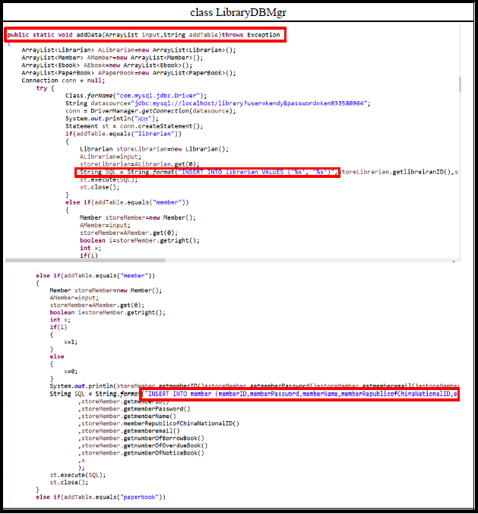
3-3. Logical Chhesion-1

Slide 17
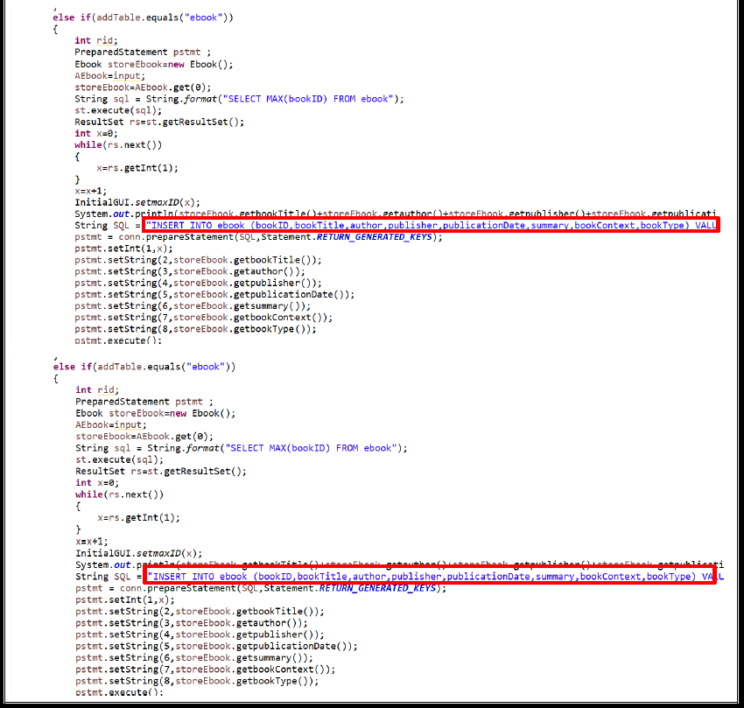
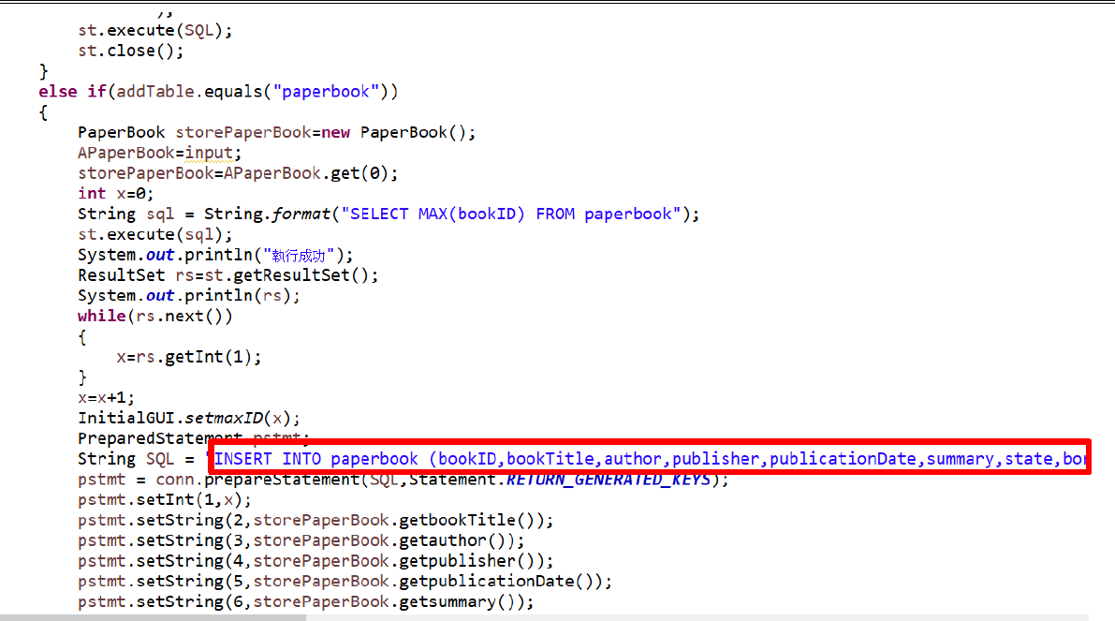
3-3. Logical Chhesion-2

Slide 18
(4) Connascence

Slide 19
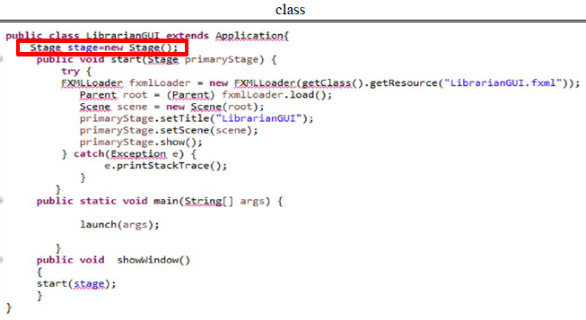
4-1. Type of Class Connascence

Slide 20
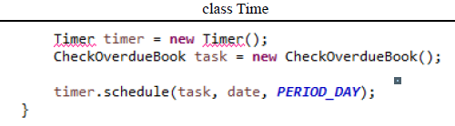
4-2. Name Connascence

Slide 21
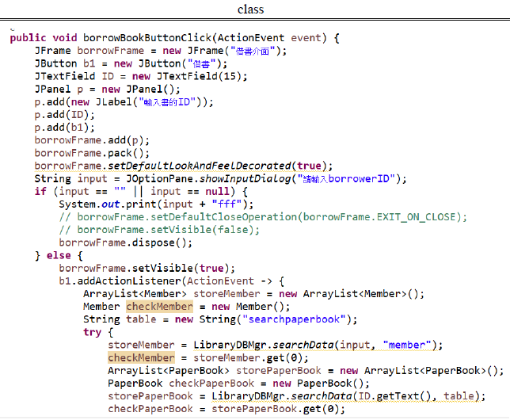
4-3. Convention Connascence

Slide 22
(5) CRC Card

Slide 23
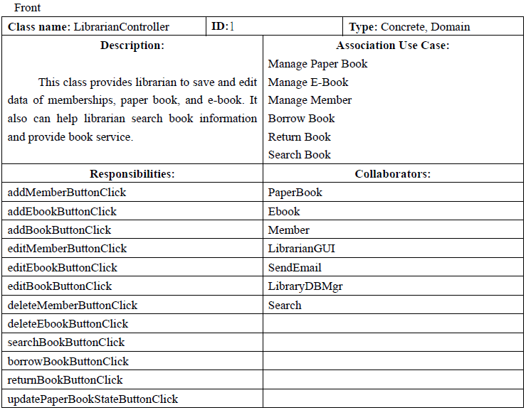
5. CRC Card

Slide 24
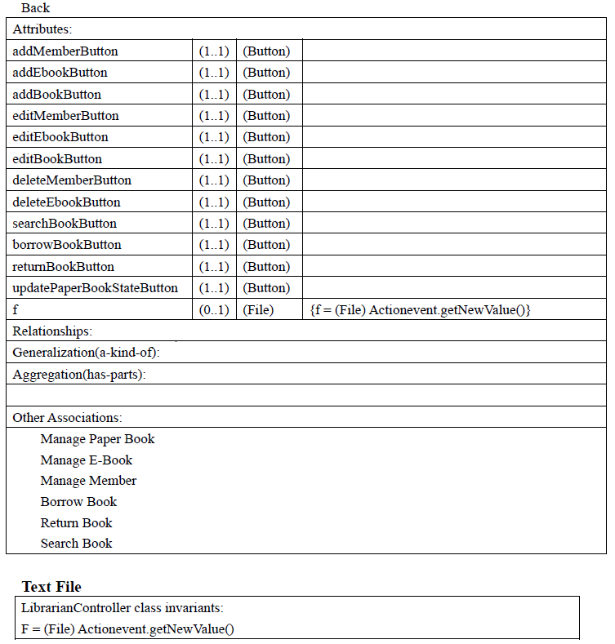
5. CRC Card

Slide 25
(6)
Contract Method specification Activity diagram

Slide 26
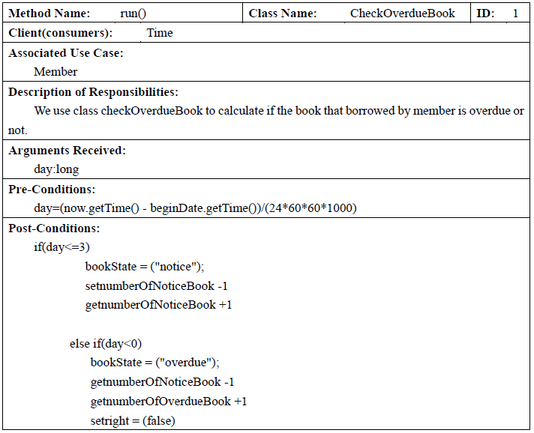
6-1. Contract

Slide 27
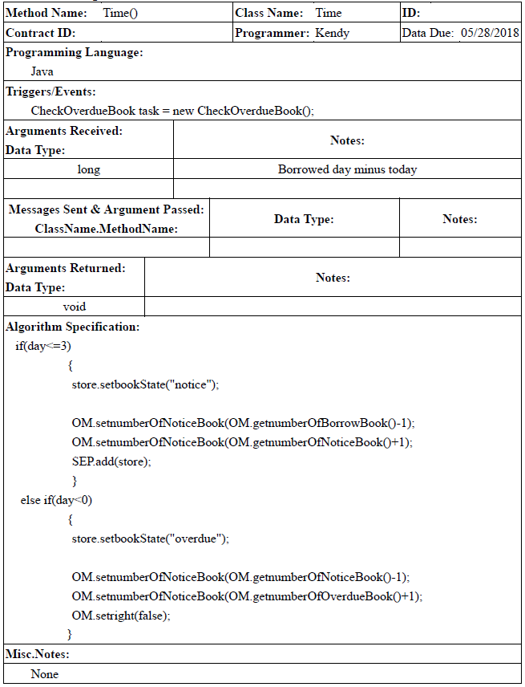
6-2. Method Specification

Slide 28
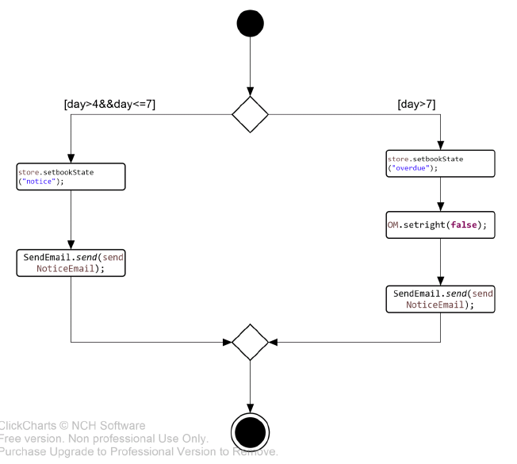
6-3. Activity Diagram

Slide 29
(7)
Data coupling Cohesion Convention connascence

Slide 30
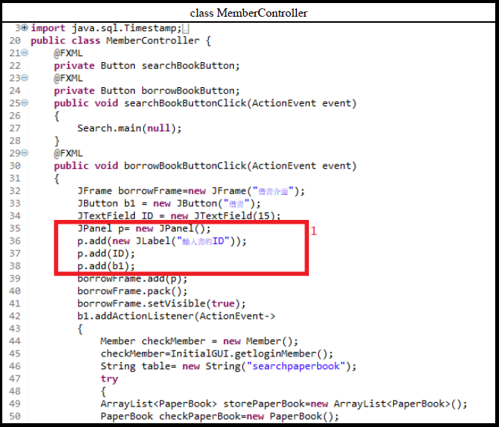
7-1. Coupling(Data Coupling)

Slide 31
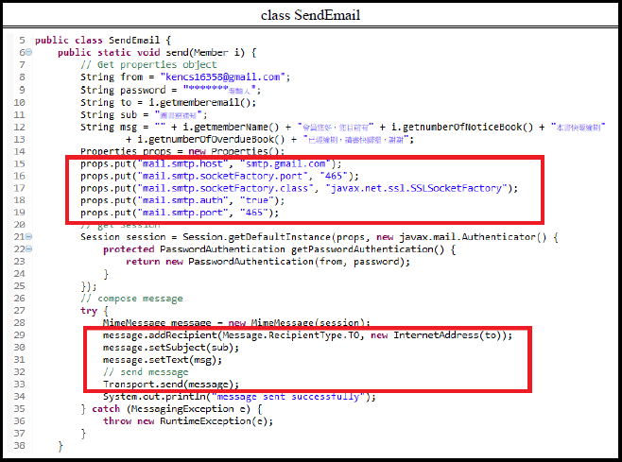
7-2. Cohesion(Function Cohesion)

Slide 32
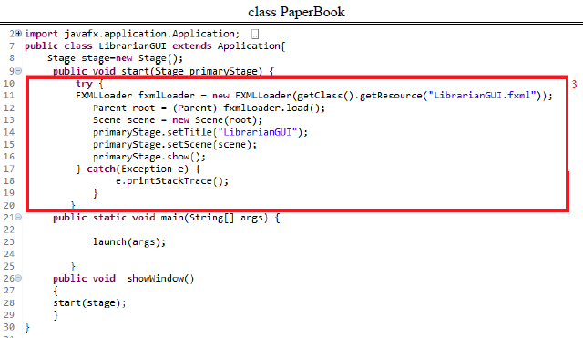
7-3. Connascence(Convention Connascence)

Slide 33
(8) Referential integrity

Slide 34
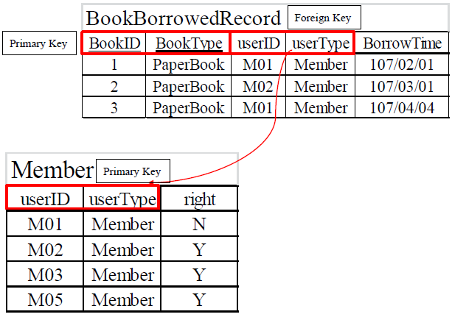
8. Referential integrity

Slide 35
(9) Normalizationions

Slide 36
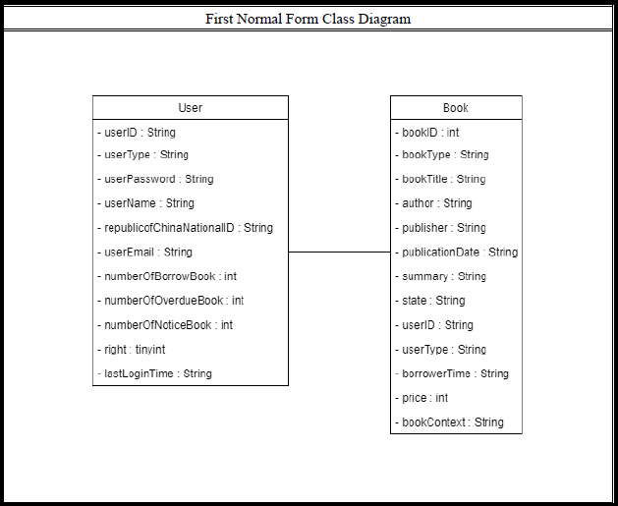
9. Class Diagram-1

Slide 37
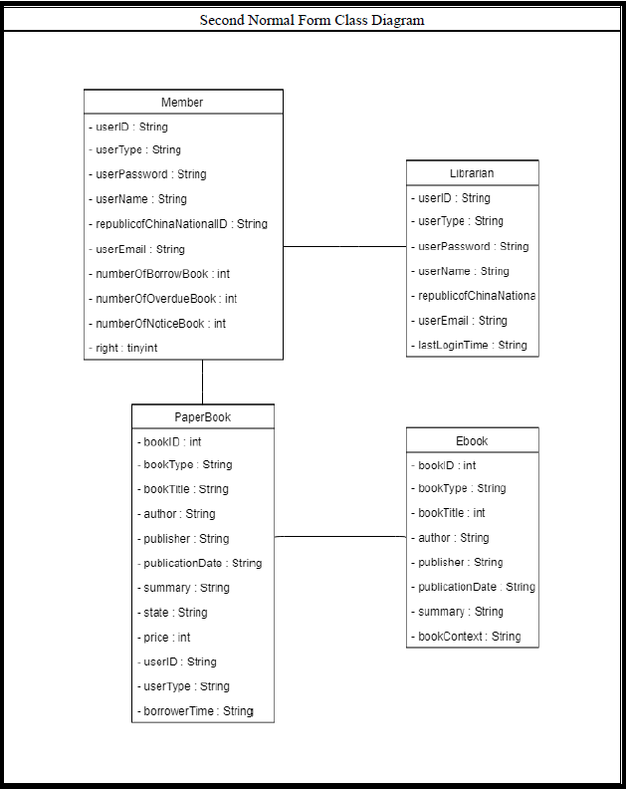
9. Class Diagram-2

Slide 38
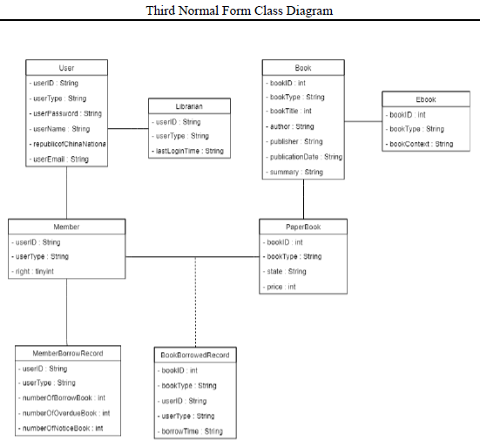
9. Class Diagram-3

Slide 39
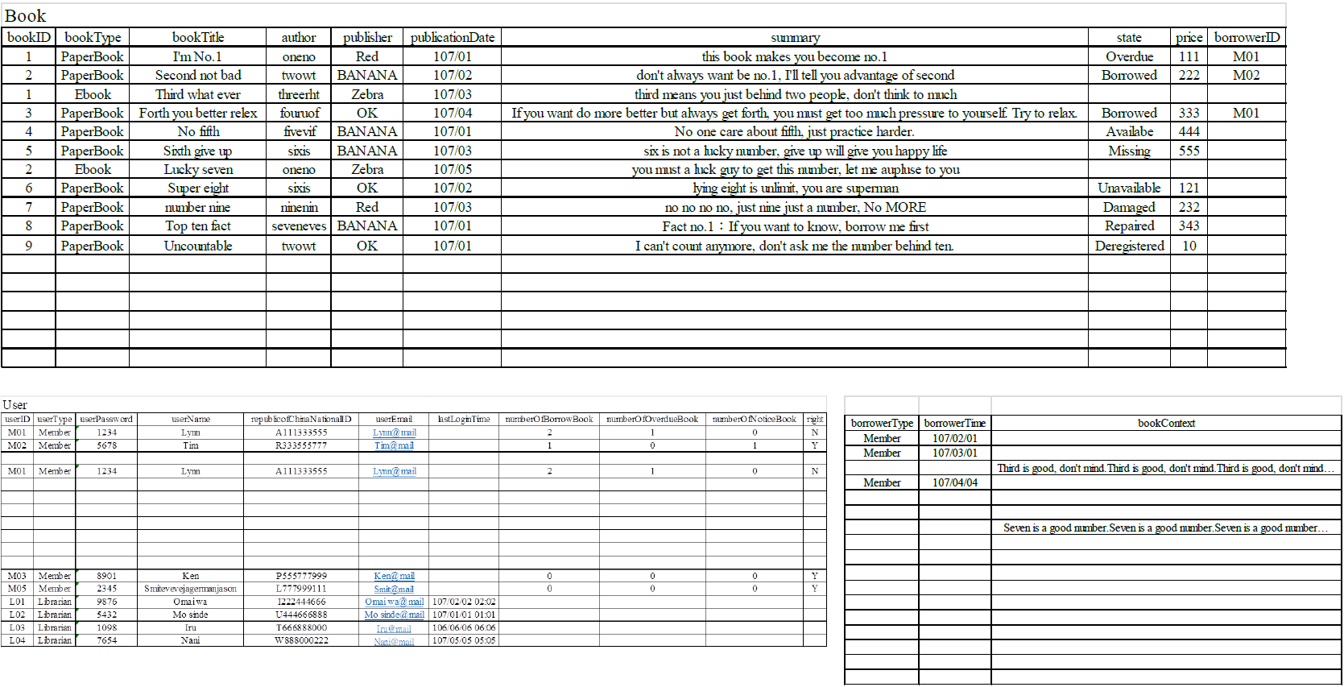
9. Zero Normal Form

Slide 40
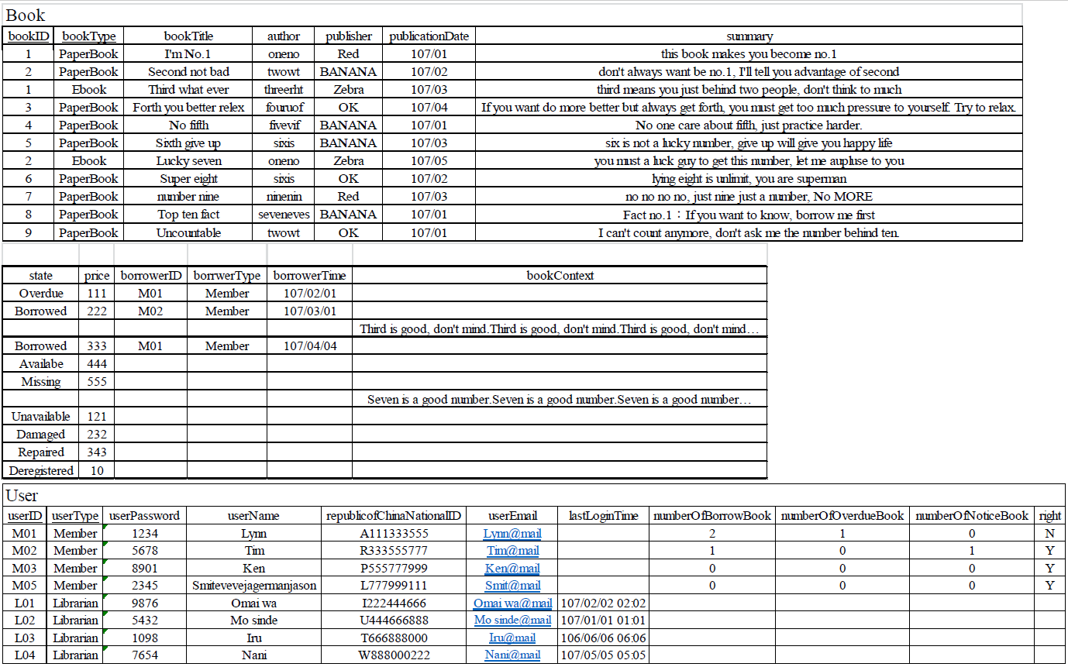
9. First Normal Form

Slide 41
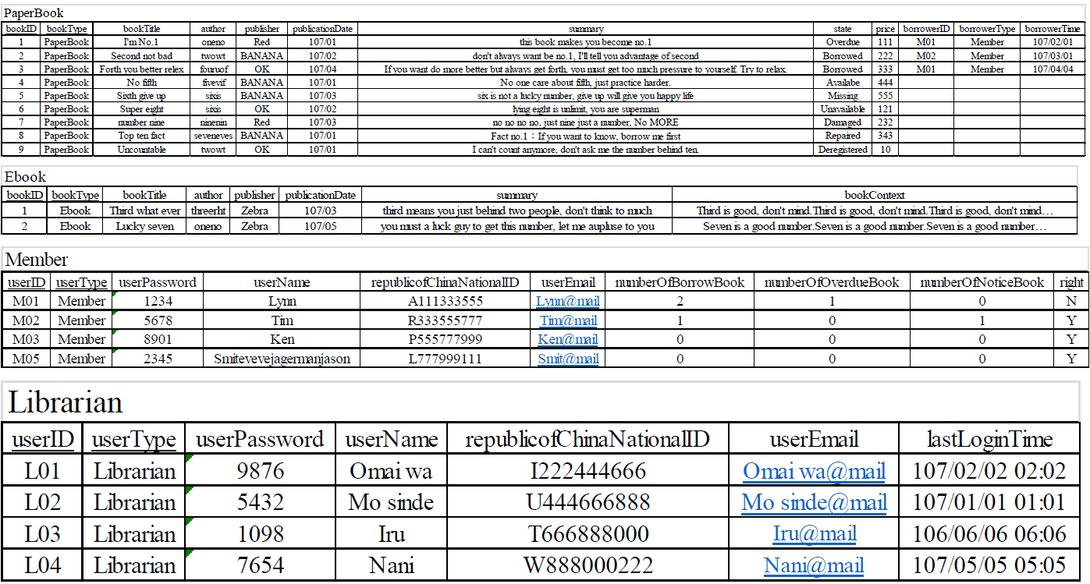
9. Second Normal Form

Slide 42
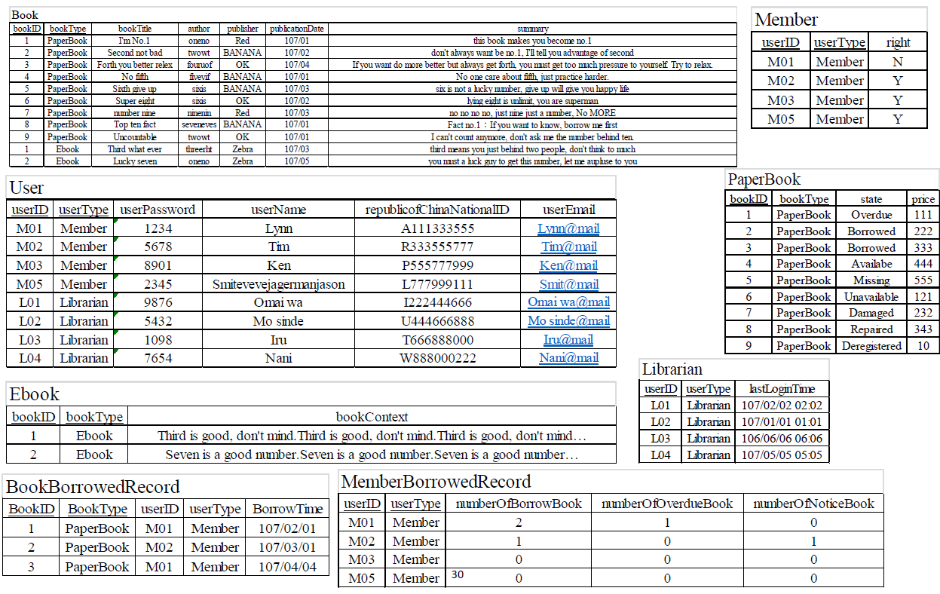
9. Third Normal Form

Slide 43
(10) Denormalize and New Class diagram

Slide 44
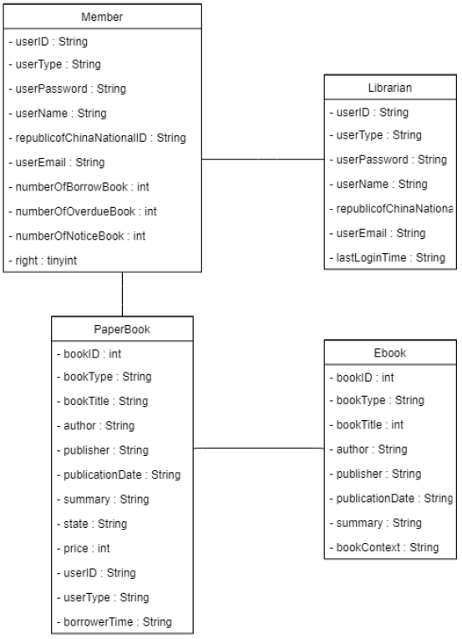
10. Class Diagram

Slide 45
(11) Inter-file clustering and Index strategies

Slide 46
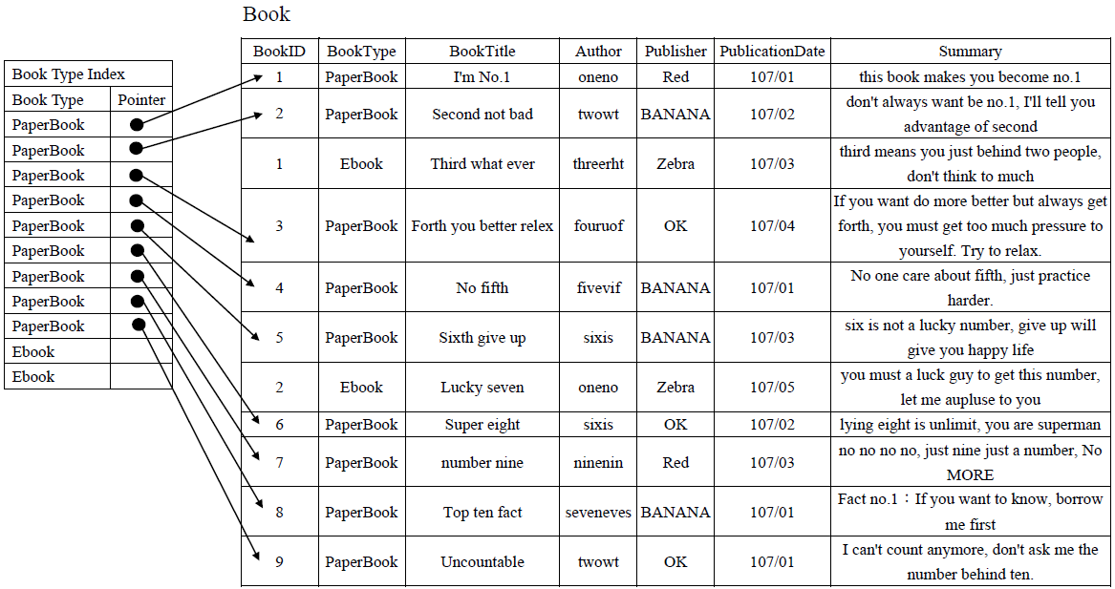
11. Inter-file clustering and Index strategies-1

Slide 47
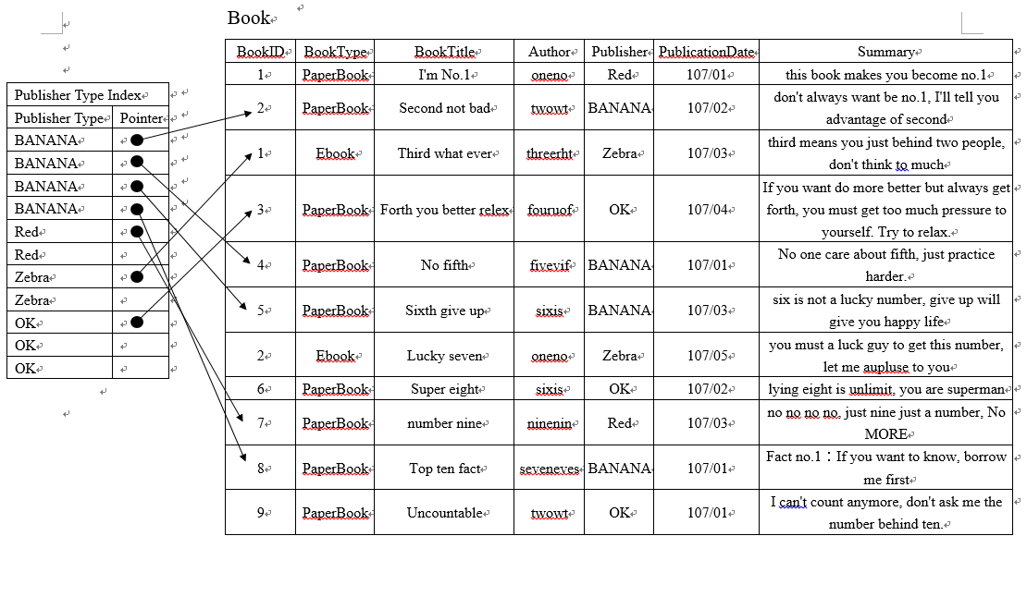
11. Inter-file clustering and Index strategies-2

Slide 48
Thank you!

